Slide 1
Spotify Data Analysis

Slide 2
Project Overview:
Whos this data for? Labels, Music Manager, Marketers
Data provided by Spotify API
We looked to answer three questions when it came to our analysis
How much of a role do spotify's specified attributes play in a songs overall popularity
How has popular music changed over the last 50 years?
Has Quarantine affected people’s music taste?

Slide 3
Spotify Audio Attributes
Acousticness
Danceability
Duration_ms
Energy
Instrumentalness
Liveness
Loudness
Speechiness
Tempo
Valence
Popularity

Slide 4
Do Spotify Attributes Affect Popularity?
Process Steps:
Connect to API and print dataframe from Spotify’s Top 50 Global Playlist
Clean Data and create new dataframe featuring only the columns we need
Create dummy variables for the genres to see if they have any correlation to popularity
Run linear regression: Popularity being the dependent variable and all other attributes as the independent

Slide 5
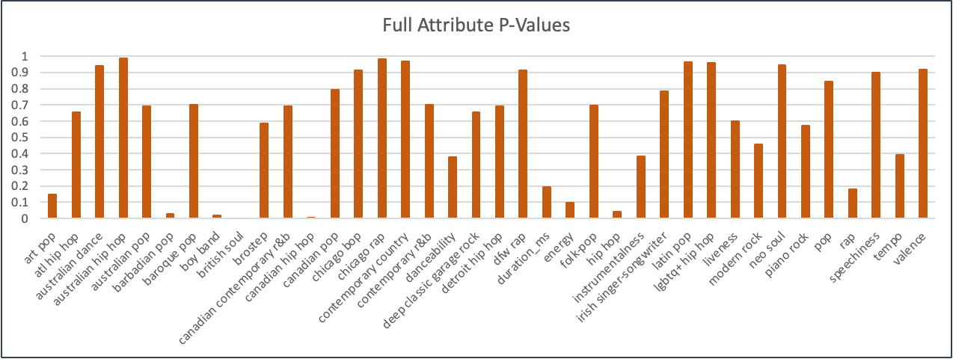
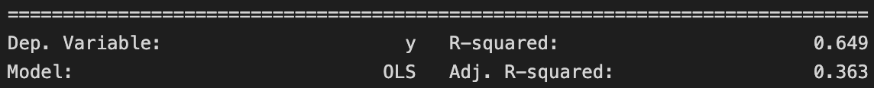
Linear Regression Results

Slide 6
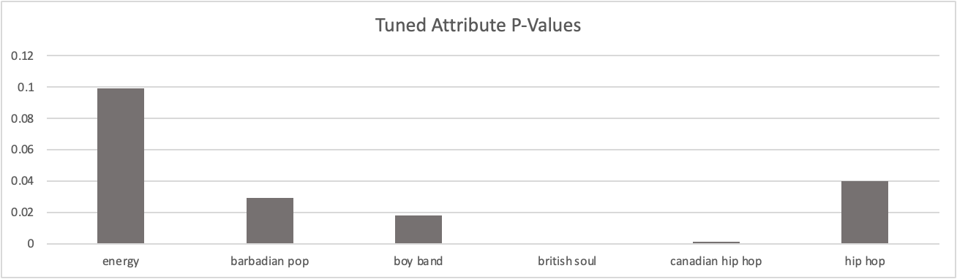
Tuned Linear Regression Results

Slide 7
Regression Conclusion
There is not strong sufficient evidence that the attributes directly affect a tracks popularity
The audio features mostly do not have any effect on popularity
Meanwhile some genres can be seen as having a small effect
It’s important to note the model is not a one size fit all model more analysis could be done to see if there is any correlation

Slide 8
How has popular music changed over the last 50 years?
Process steps:
Connect to Spotify API, collect “top hits” data from 1970-2023
Created DataFrames for each “Top 100” songs for every 5 years from 1970-2023
Appended the mean of sound features into a list
Created line graphs to show trends in sound features over the years
Created Pie charts to show genre breakdown
Did statistical analysis to see STD

Slide 9
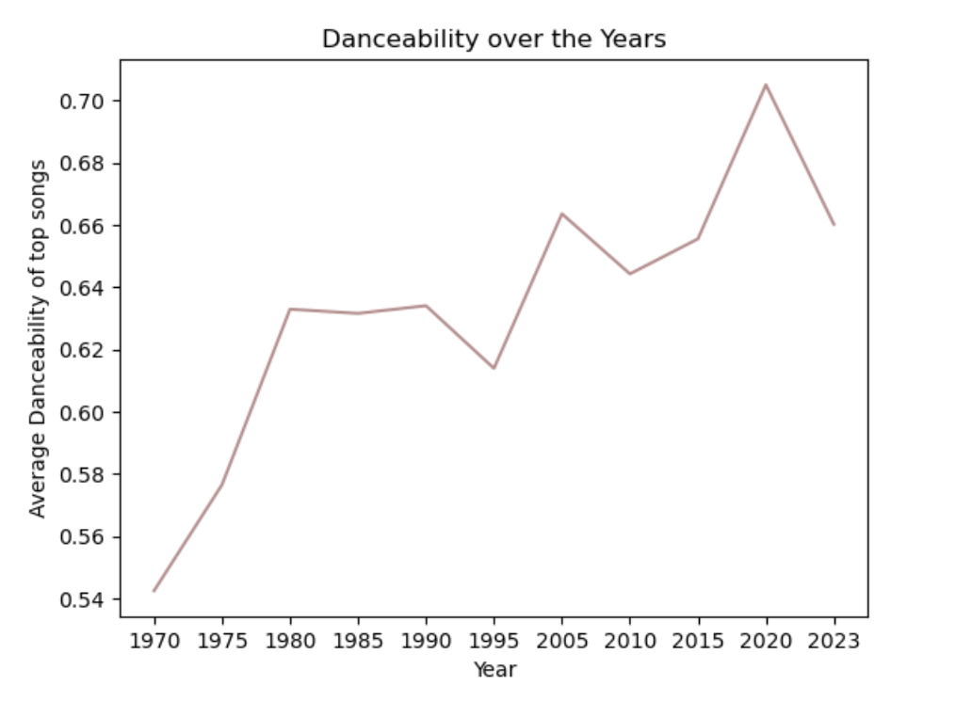
Danceability Mean from 1970-2023
Danceability is the measure of how suitable a track is for dancing
Tempo
Rhythm stability
Beat strength
Increase in danceability may come from a rise in latin/caribbean music
Shakira
Rihanna
Latin music mean danceability: 0.746746

Slide 10
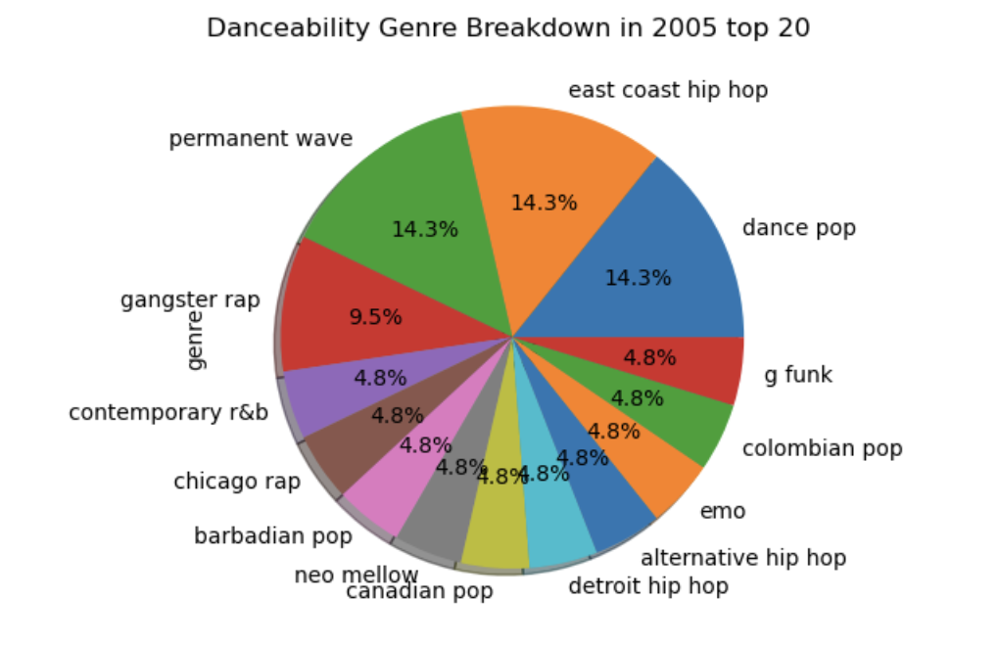
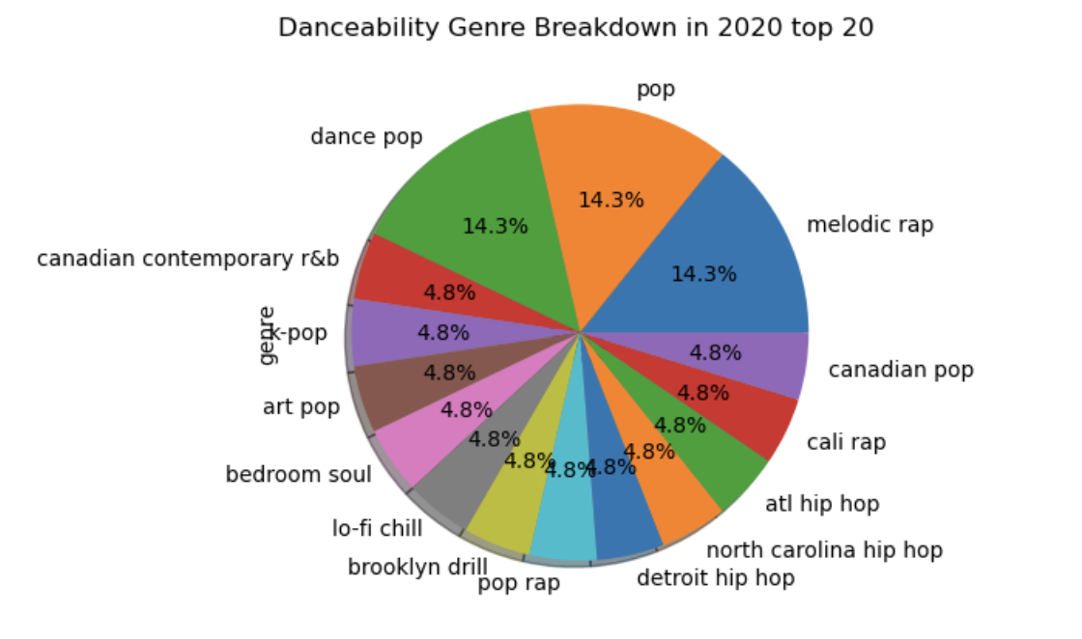
Danceability & Genre Pie Chart

Slide 11
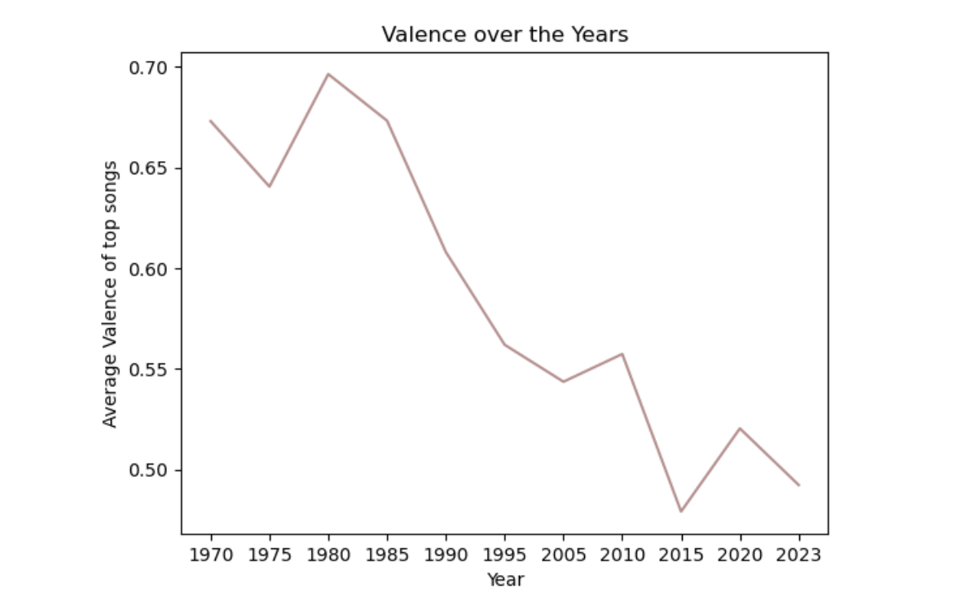
Valence Mean from 1970-2023
Analysis:
Valence is the measure of a songs positivity
High valence= happy song
Reflection of society
Religion
Sharing of ideas through music
Idea that sad music became popular—> other artist follow suit

Slide 12
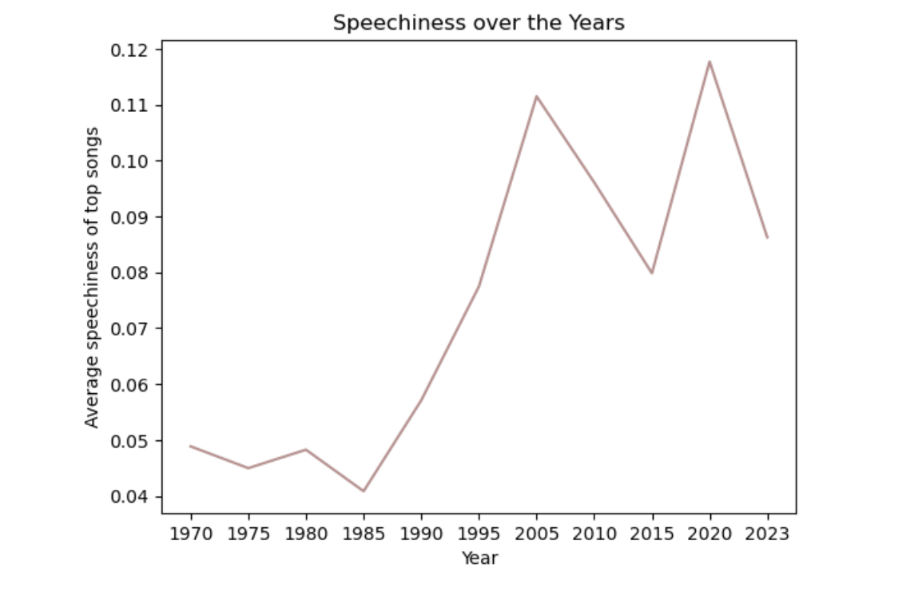
Speechiness Mean from 1970-2023
Analysis:
A level of how much spoken word is on the track
In this case, lyrics
Rap saw a major increase in 1990’s

Slide 13
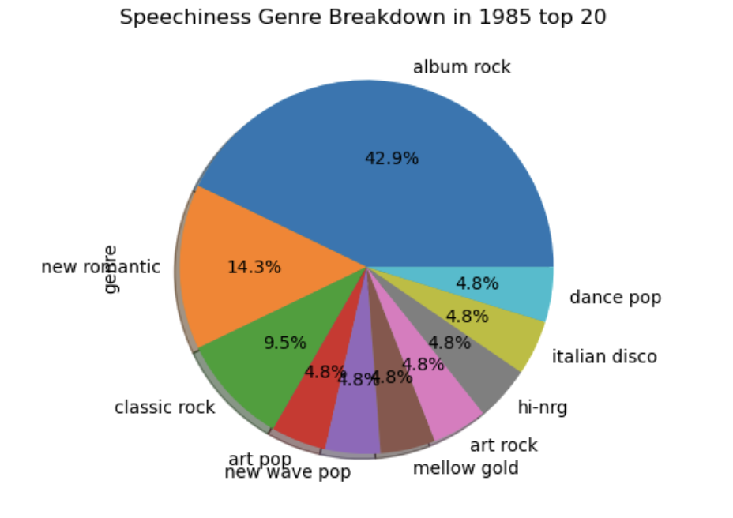
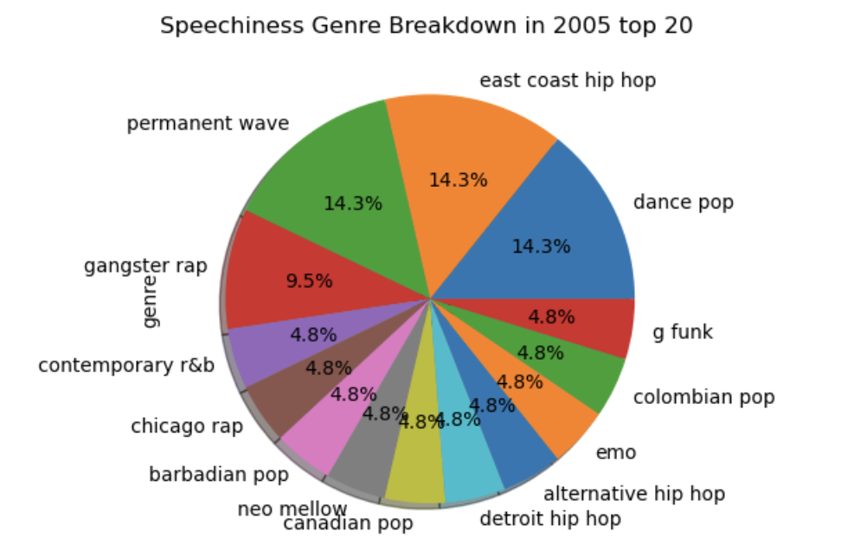
Speechiness & Genre Pie Chart

Slide 14
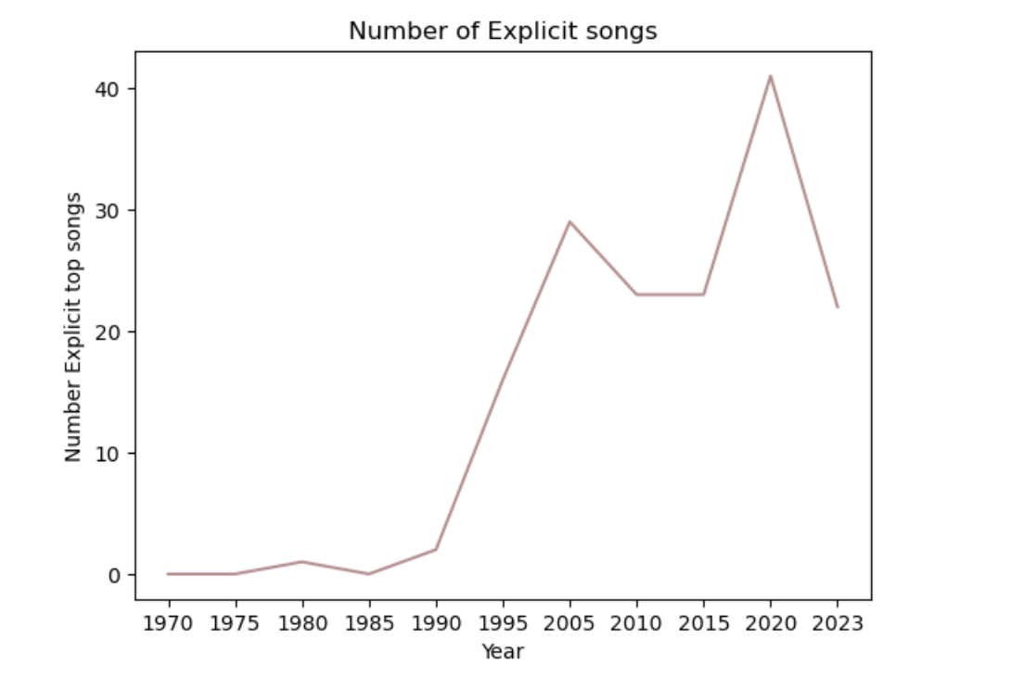
Number of Explicit Songs 1970-2023
Increase in Hip Hop and R&B
Less pressure from record labels to keep songs clean
Societal shifts on being explicit/bold

Slide 15
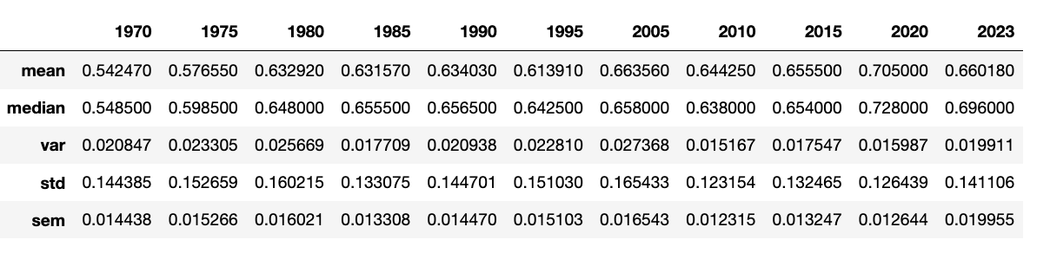
Statistical Analysis on Danceability
Notes:
Showing that although mean/ median have gotten higher, std and var have less change. Implying that artists/listeners are moding to the changes seen over the last 50 years.

Slide 16
50 Year Trend Analysis
This information can be important for both record labels and artists
Helps with deciding what music is trending towards
Potentially helping with creating music for artists
Helps guide record labels towards artists who may fit into popular trends

Slide 17
During Quarantine how has music taste changed?
Have people’s taste in genre’s changed or broadened?
Are there any genres that remain most popular?
Steps:
Connect to Spotify API make dataframes based on genre specific playlists..
Use Kaggle datasets based on Spotify to compare genres over years cleaning data and targeting years of interest.

Slide 18
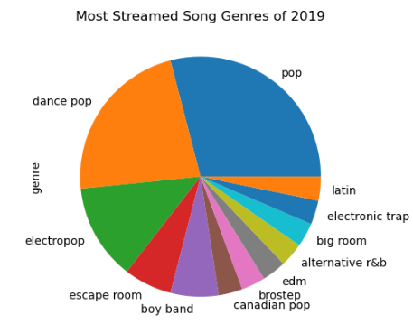
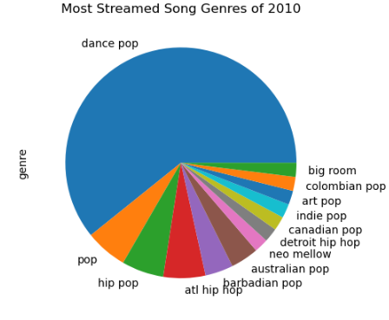
Most streamed songs of 2010 vs 2019
Notes:
There has been an overall shift in what music is being streamed more. You see dance pop lessening and new non pop genres on the charts like alt r&b and electronic trap.

Slide 19
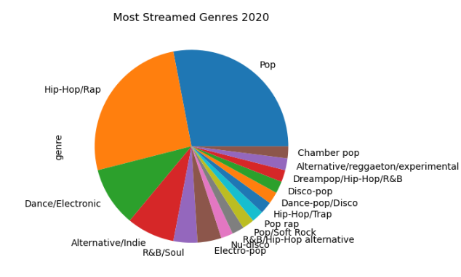
Most streamed songs of 2019 vs 2020
Notes:
Between 2019 to 2020 there have more more variety of genres being streamed.

Slide 20
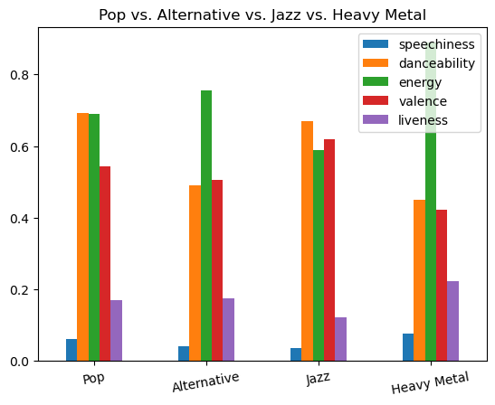
What attributes may contribute to most streamed?
Taking popular genres from most streamed songs such as Pop and Alternative and comparing the attributes to a genre that isn’t typically on top charts like Heavy Metal and Jazz.
Heavy Metal has a much higher energy level and lower danceability.
Jazz has higher valance but lower liveness.
Notes:
The genres are pretty similar when accounting for 5 key attributes such as speechiness, danceability, energy, valence, liveness
Of the two genres on 2020’s most streamed Liveness is fairly identical along with speechiness.
Areas that vary for the genres not on the most streamed list include Jazz and Heavy Metal with heavy metal having a much higher energy level and lower danceability when compared to alternative and pop.
Energy - The energy of a song - the higher the value, the more energetic. song
Danceability - The higher the value, the easier it is to dance to this song.
Valence - The higher the value, the more positive mood for the song.
Speechiness - The level of spoken words in a track.
Liveness - The likelihood track was performed live.
Jazz has higher valance when compared to pop and alternative but lower liveness.

Slide 21
Genres Conclusion
In conclusion, tastes in genre have broadened over the past decade and further so during Quarantine for Covid - 19.
Within the top streamed songs genres such as Pop and Alternative have slightly different attributes when compared to genres that aren’t typically top streamed such as Jazz and Heavy Metal.
Heavy Metal has a much higher energy level and lower danceability whereas Jazz has higher valence but lower liveness.
This could suggest people prefer a specific range of danceability and valence when choosing what to listen to.

